Slide 1
Probability
EQ – How do I calculate probabilities of combined events using tree diagrams?
Mrs James
Year 10

Slide 2
Lesson objective
By the end of this lesson you will be able to;
Constructs and uses tree diagrams to calculate probabilities
B grade and above: Constructs and uses tree diagrams to calculate probabilities in situations involving replacement and where there is no replacement
Notes:
Lesson

Slide 3
24
7
30
Date
Probability
EQ: How do I calculate probabilities of combined events using tree diagrams?
Tree diagrams can be used to list the sample space for experiments involving two or more components.
Branch probabilities are used to describe the chance of each outcome at each step.
The probability of each outcome for the experiment is obtained by multiplying the branch probabilities.
Branch probabilities will depend on whether selection is made with or without replacement.
For with replacement, probabilities do not change.
For without replacement, probabilities do change.
Notes:
Input

Slide 4
Example 1: We will do this together
5_Tree diagrams activities worksheet

Slide 5
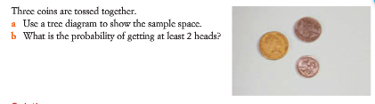
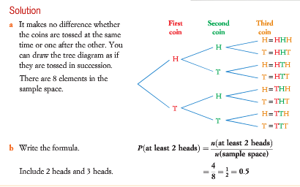
Example 2: We will do this together
Notes:
Input

Slide 6
Your turn: Glue the following worksheet into your Interactive notebook
5_Combined events_tree diagrams worksheet

Slide 7
Your turn to practice
This PowerPoint and worksheets will be on CONNECT to support your revision and study of this topic.
Homework/Revision
Finish off all of the work associated with this PowerPoint
Write your summary of this topic
Those that want to go further check out the next set of slides

Slide 8

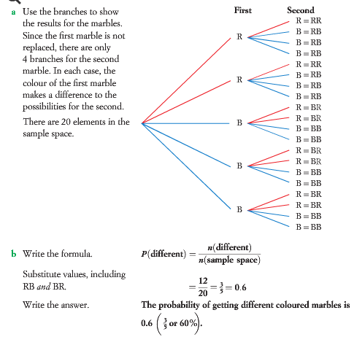
Your turn: Complete this in your Interactive notebook
B grade: Constructs and uses tree diagrams to calculate probabilities in situations involving replacement and where there is no replacement
Example:
Notes:
Guided practice

Slide 9
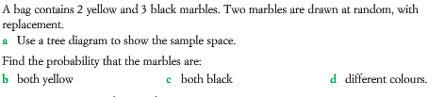
Your turn:
1.
2. Repeat question 1 without replacement

